Slide 1
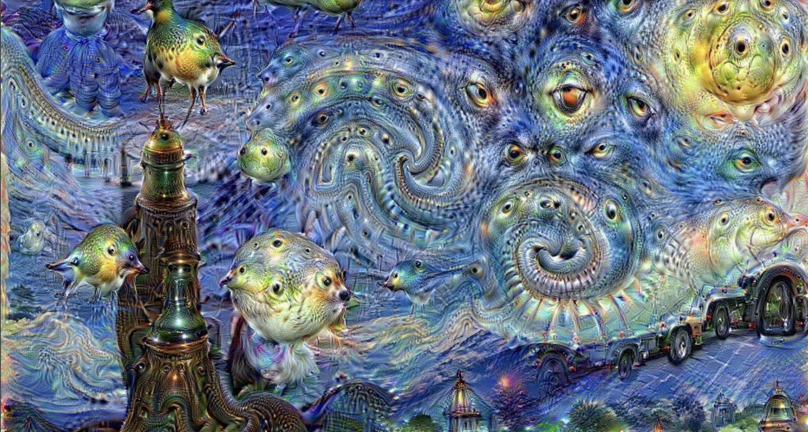
Audio Style Transfer
Brennan Mahoney, Roger Finnerty, Jack Edelist, Amruth Niranjan, Zane Mroue
Boston University CS/ECE 523 Deep Learning Project
Notes:
zane

Slide 2
Motivation & Task
Initial motivation: change the gender/accent of song acapellas
Potential challenges:
Computationally expensive training procedures
Difficult to capture nuances between accents
Audio reconstruction using spectrograms
Approach:
Perform style transfer on shorter speech samples: gender, instrument, accent
Compare 4 models for style transfer of Mel Spectrograms
1-layer CNN, VGG-19, Vision Transformer, ResNet
Implement a DL model for audio reconstruction
Qualitative comparison of style-transferred audio
Notes:
zane

Slide 3
Related work
[1] "Image style transfer using convolutional neural networks."
Utilizes a pre-trained CNN to separate and recombine content and style from distinct images.
Employs a loss function that minimizes the difference in content and style between the target and generated images.
Demonstrates successful style transfer by adjusting the feature correlations in convolutional layers.
[2] "How to Convert Audio to Mel-Spectrogram to Audio."
Describes the conversion of audio to mel-spectrograms using the Librosa library, focusing on feature extraction for audio analysis.
Details the inverse process to reconstruct audio from mel-spectrograms, emphasizing preservation of audio characteristics.
Provides Python code snippets to facilitate hands-on application of theoretical concepts in audio signal processing.
Notes:
Brennan

Slide 4

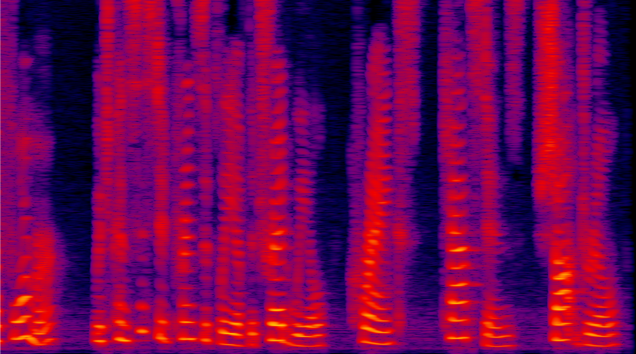
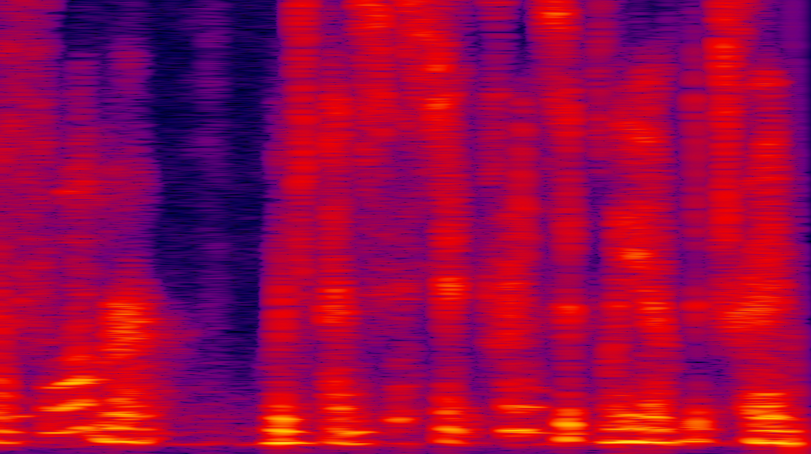
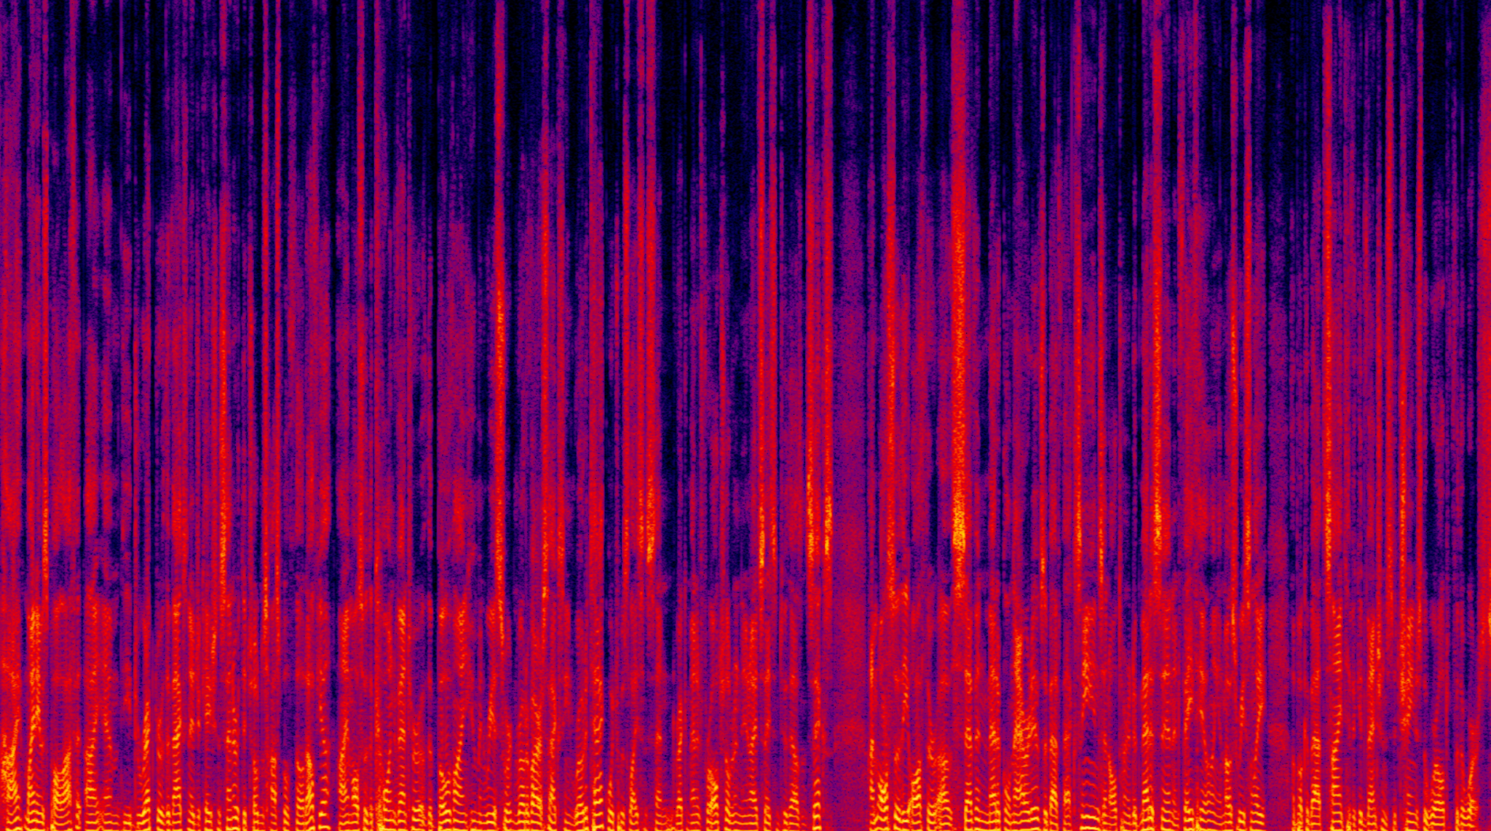
Approach
Step 2: Convert the audio files to spectrogram images
Step 3: Execute style transfer
Step 4: Obtain output in image format
Step 5: Convert the spectrogram back to .wav data
Step 1: Obtain .wav data
Preprocess
Style Transfer
Audio Reconstruction
Preprocess
VGG19
ResNet
Vision Transformer
Notes:
Brennan
Preprocessing = resample audio to the same sampling rate

Slide 5
Datasets
ImageNet (VGG and ViT pretraining)
14M + images, standard CV benchmark dataset
Content audio: LJ Speech Dataset
Public domain speech dataset (from audiobooks)
13,100 short audio clips (1 - 10 sec)
Style audio: variety of clips (gender, accents, instruments)
English Multi-speaker Corpus for CSTR Voice Cloning Toolkit
Notes:
amruth
https://keithito.com/LJ-Speech-Dataset/
https://datashare.ed.ac.uk/handle/10283/2651
The WaveNet model is pretrained on the LJ dataset
The output of the style transfer should match the structure of the LJ speech clips, so it makes sense for WaveNet to be pre-trained on these

Slide 6
[Audio → Mel Spectrogram → Audio] Conversion
Mel Spectrograms:
Applies a frequency-domain filter bank to audio signals that are windowed in time
Uses the Mel Scale on y-axis (non-linear transformation of the frequency scale)
Short-time Fourier Transform + Griffin-Lim algorithm
STFT: visual representation of the STFT that displays the frequencies present in an audio signal as they change over time
GLA: phase reconstruction method that estimates signals from modified short-time Fourier transforms
WaveNet
Deep neural network for generating raw audio
Notes:
jack

Slide 7
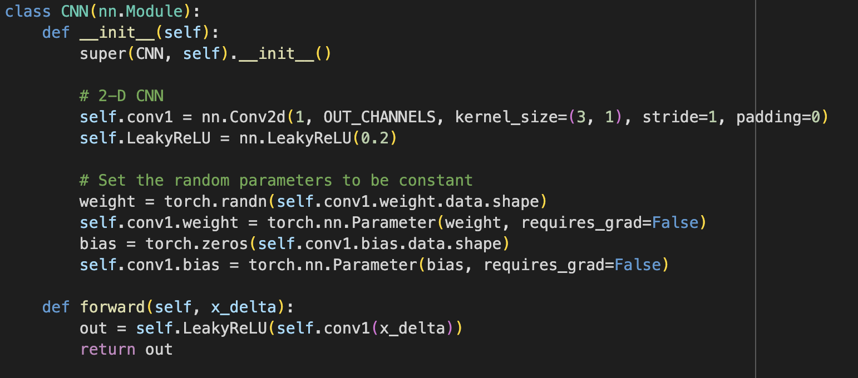
Initial Results: Single-Layer CNN [STFT & GLA] (½)
num_epochs = 20000
learning_rate = 0.002
style_param = 1
content_param = 1e2
Notes:
jack

Slide 8
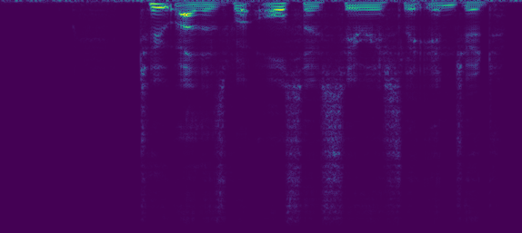
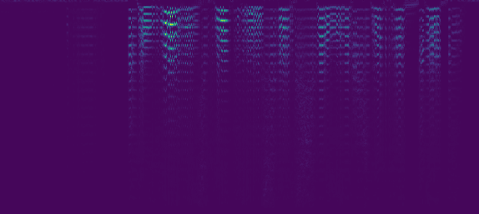

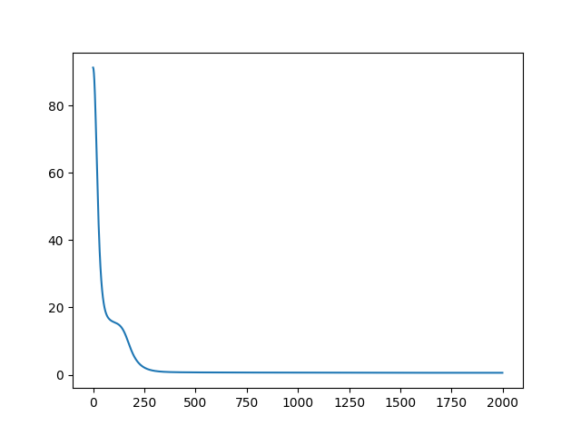
Initial Results: Single-Layer CNN (2/2)
Content spec
Style spec
Generated spec
Loss curve
Notes:
jack

Slide 9
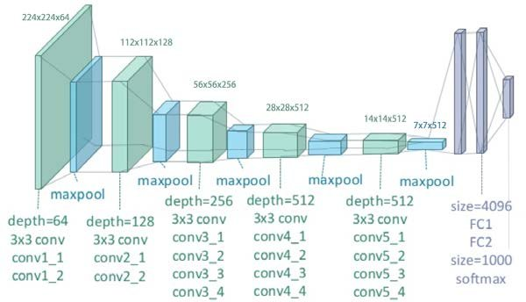
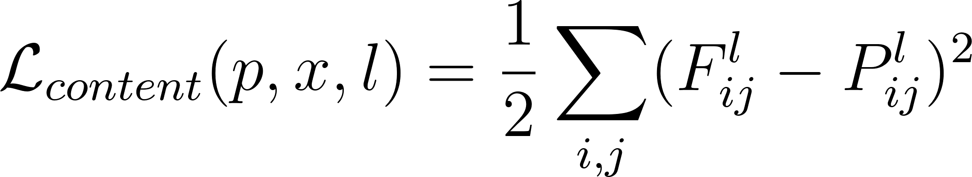
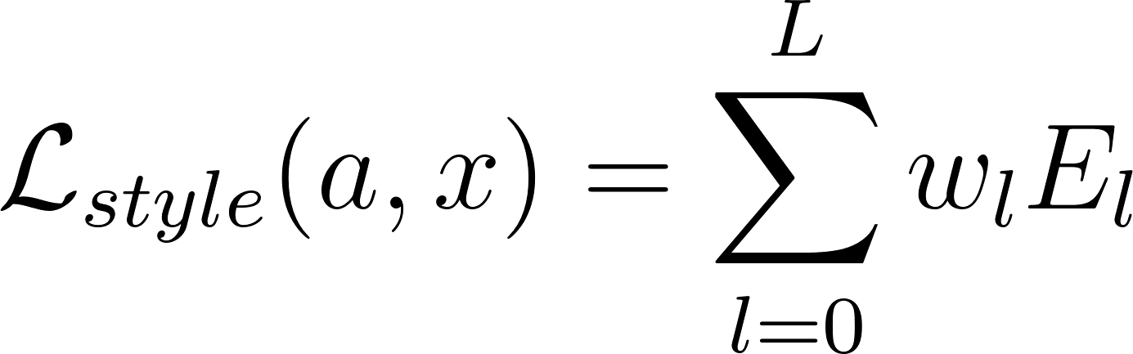
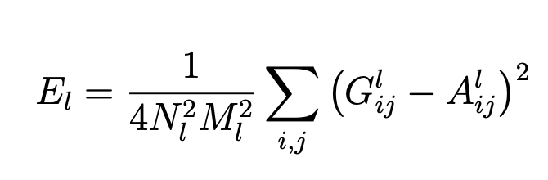
Style Transfer: VGG19 Backbone (Gatys et al)
Notes:
Roger
Content loss → euclidean distance
P_l = representation of original @ layer l
F_l = representation of generated @ layer l
Style loss
A = original Gram matrix @ style layer
X = generated Gram matrix @ style layer

Slide 10
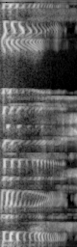
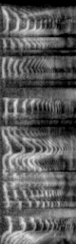
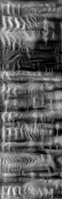
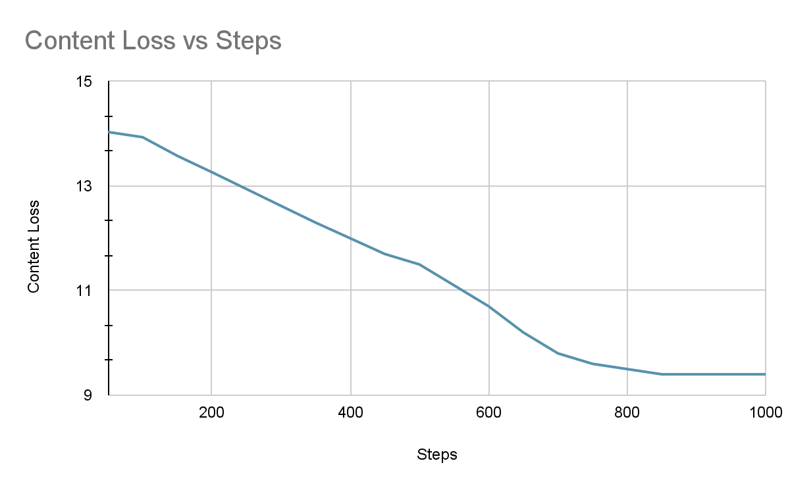
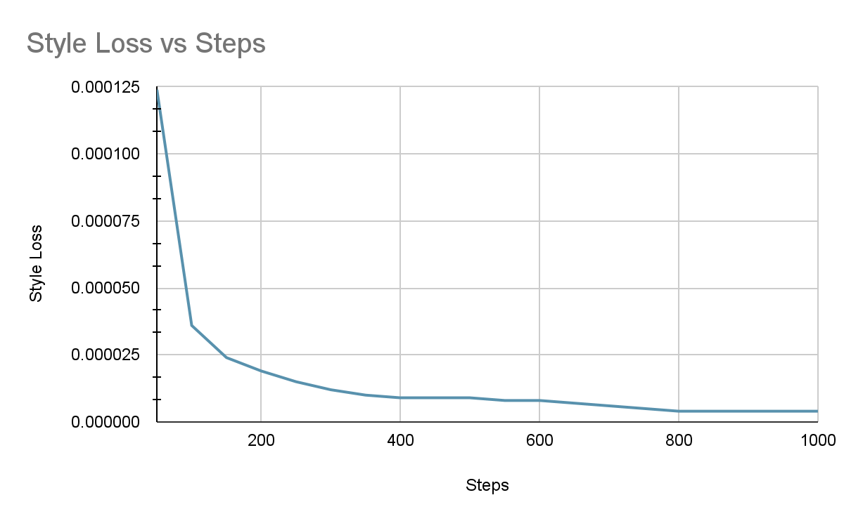
Results for VGG19 (Accent transfer)
Content Spectrogram
Style Spectrogram
Output Spectrogram
Notes:
Brennan

Slide 11
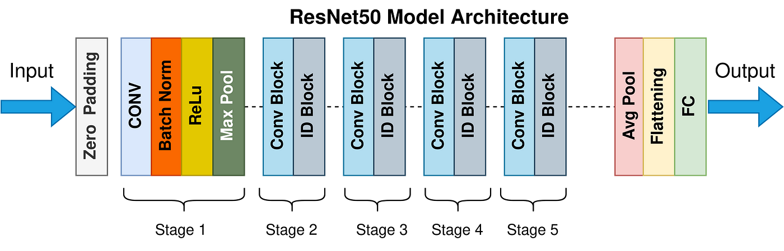
Style Transfer: ResNet Backbone
ResNets are built out of blocks called "residual blocks" or "residual units." Each block has a shortcut or "skip connection" that allows the input to the block to be added directly to the output of the block. Deeper layers perform at least as well as the shallower ones
The residual learning framework allows deeper ResNet models to perform complex transformations without losing low-level details, which is crucial for capturing and modifying nuanced audio characteristics like accents or speech styles
Notes:
zane
https://towardsdatascience.com/the-annotated-resnet-50-a6c536034758

Slide 12
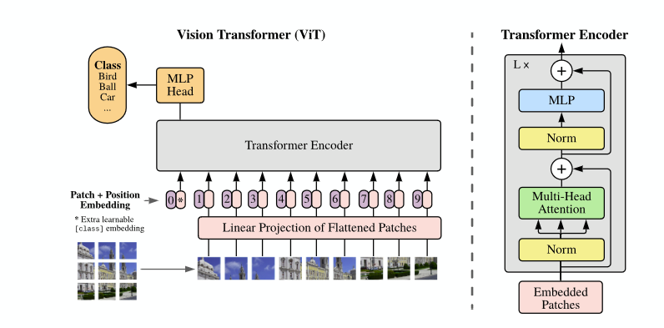
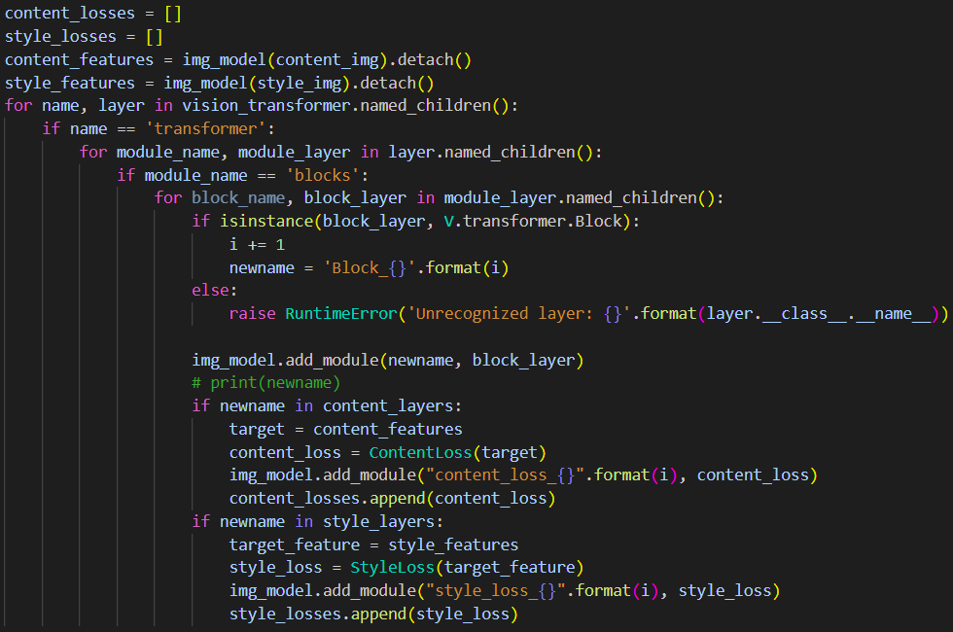
Style Transfer: Vision Transformer
Model used contains 12 embedding blocks (middle)
NST feature extraction executed at the output of each block
Notes:
Amruth

Slide 13
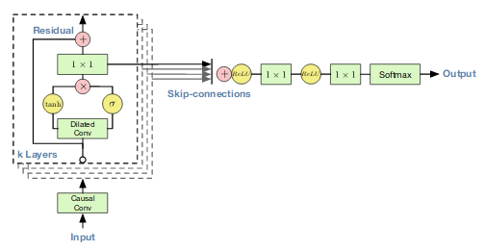
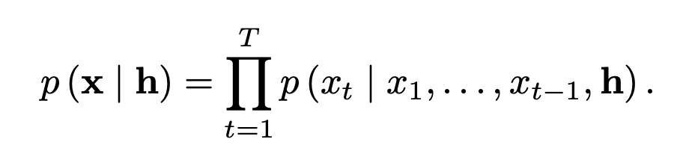
WaveNet Architecture
Probabilistic model for generating raw audio
Joint conditional probability for audio generation
Notes:
Roger
Our second approach to audio reconstruction…
Deep learned model that generates raw audio by modelling the probability of an output audio joint probability over all previous output samples, using causal convolutional layers to ensure that future elements of the input do not affect output
We used open source code that retrofitted this architecture to be conditioned on spectrogram data and was trained on the LJ speech dataset
We were able to download the pretrained weights for this version of the model → naturally we used these weights and kept the content audio from the LJ speech

Slide 14

Experimental Results
1 Layer CNN + STFT + Griffin-Lim Algorithm
Content Audio | Style Audio | Output from style transfer
 | Gender
 | Instrument
 | Accent
VGG19 backbone + WaveNet
Content Audio | Style Audio | Output from style transfer
 | Gender
 | Instrument
 | Accent
Notes:
jack

Slide 15
Experimental Results (cont.)
ResNet backbone + WaveNet
Content Audio | Style Audio | Output from style transfer
 | Gender
 | Instrument
 | Accent
(Future work): VGG19 + ESRGAN (super resolution) + WaveNet
Content Audio | Style Audio | Output from style transfer
 | Gender
 | Instrument
 | Accent
Notes:
Roger
Explain why super resolution didn’t work for this model because pretrained weights had certain convolutional dimensions

Slide 16
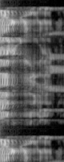

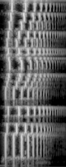
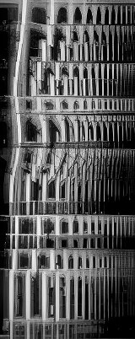
Super Resolution (ESRGAN)
Content
Style
Notes:
Roger
-open source deep learned model for super resolution

Slide 17
Conclusion + Future Work
Spectrograms alone fail to capture subtle differences between accents (for speakers of the same gender)
Recurrent architectures (ViT) struggle to encode any meaningful information at all (at the moment)
Training should be targeted to one specific style transfer task (accents, timbre, pitch, gender, etc.)
Future work:
Super resolution to increase spatial dimension of spectrograms
Develop new methods to perform NST using recurrent architectures like ViT
Supervised learning → add a label to audio clip (ground truth accent), like conditional diffusion
Notes:
amruth

Slide 18
References
[1] Gatys, Leon A., Alexander S. Ecker, and Matthias Bethge. "Image style transfer using
convolutional neural networks." Proceedings of the IEEE conference on computer
vision and pattern recognition. 2016. URL
[2] Gaurav, "How to Convert Audio to Mel-Spectrogram to Audio." *Kaggle*,
www.kaggle.com/code/gaurav41/how-to-convert-audio-to-mel-spectrogram-to-audio. Accessed 29 Apr. 2024.
[3] Oord, Aaron van den, et al. "Wavenet: A generative model for raw audio." arXiv
preprint arXiv:1609.03499 (2016).

Slide 19
Thank you! Questions?
Notes:
Brian Kulis

